Slide 1
Levels Of Organisation

Slide 2
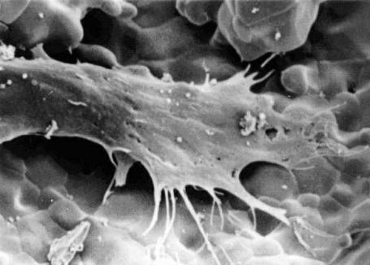
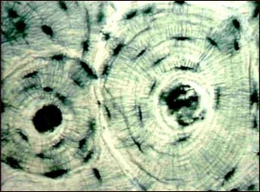
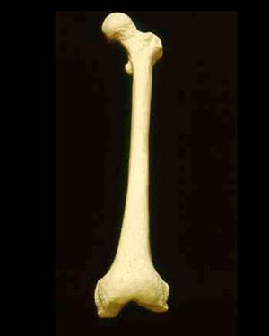
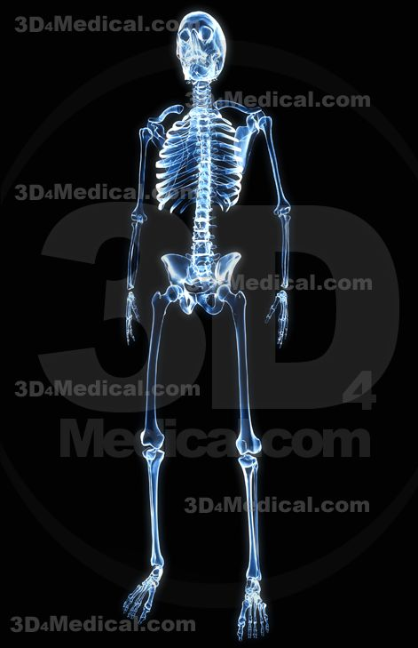
The levels of organisation from simplest to most complex are:
Cells
Tissues
Organs
System
Organism

Slide 3
Cells
The basic unit of structure and function in the human body
Though all cells perform the processes that keep humans alive, they also have specialized functions as well.
Examples may be nerve cells (neurons), blood cells, and bone cells.

Slide 4
Tissues
A group of specialized cells that work together to perform the same function.
There are four basic types of tissue in the human body:

Slide 5
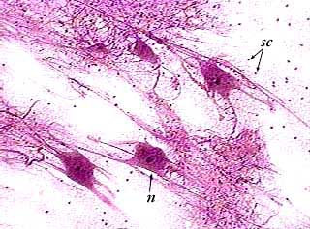
Tissues
Nerve tissue – carries impulses back and forth to the brain from the body

Slide 6
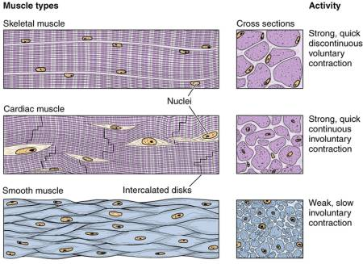
Three types of muscle tissue
Muscle tissue – (cardiac, smooth, skeletal) contract and shorten, making body parts move
Skeletal
Cardiac
Smooth

Slide 7
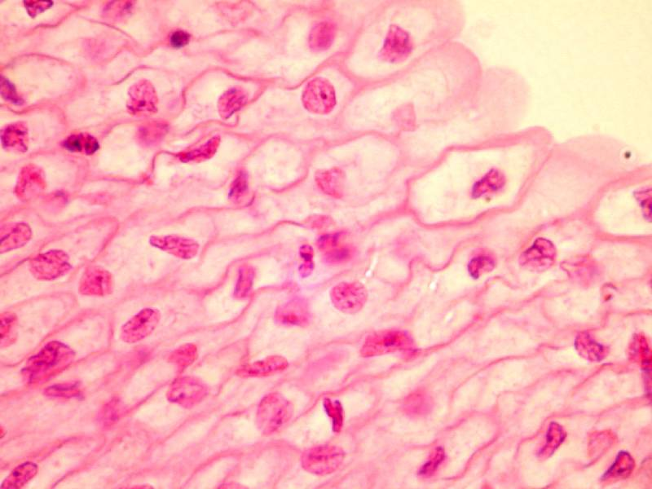
3. Epithelial tissue – covers the surfaces of the body, inside (as lining and /or covering of internal organs) and outside (as layer of skin)

Slide 8
Research and construct tables for the location and function of the list of Epithelial tissue below:
Simple Squamous.
Simple Cuboidal.
Simple Columnar
Stratified squamous
Stratified cuboidal
Stratified columnar

Slide 9
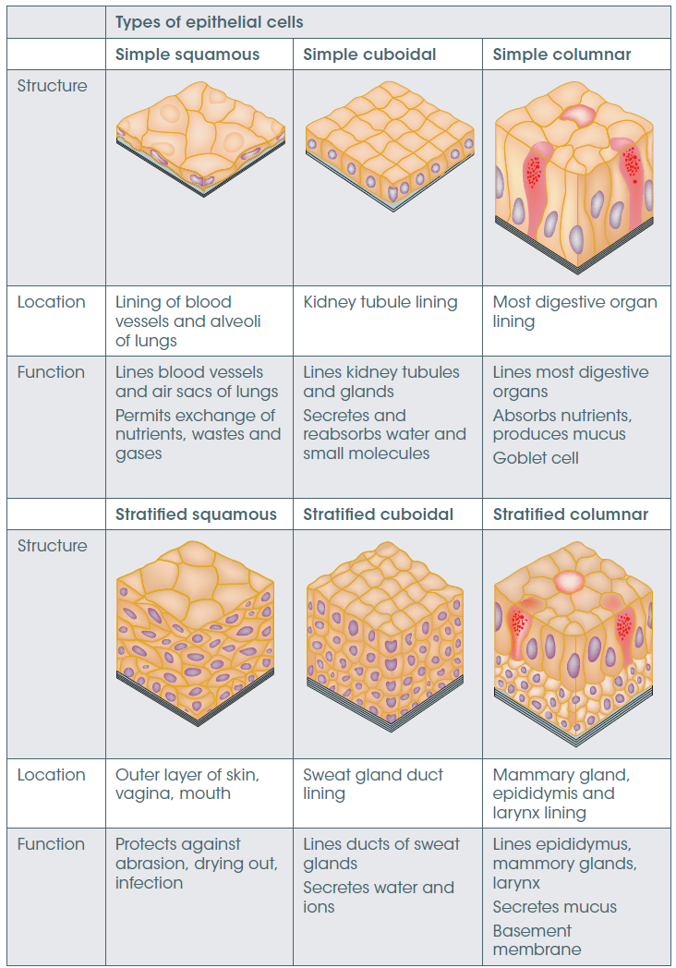
Epithelial Cells
Notes:
As well as providing a barrier and protecting organs, some epithelial tissue may be specialised to function in absorption, secretion or excretion. For example, the epithelium tissue that lines the respiratory tract secretes mucus that lubricates the surface and keeps it moist. The possession of cilia enables the mucus to move along the surface, trapping particles and sweeping them back up the trachea. This helps to keep lungs clean and healthy. Table 10.2 (page 256) summarises the different types of epithelial cells and their functions.

Slide 10
Epithelial Cells

Slide 11
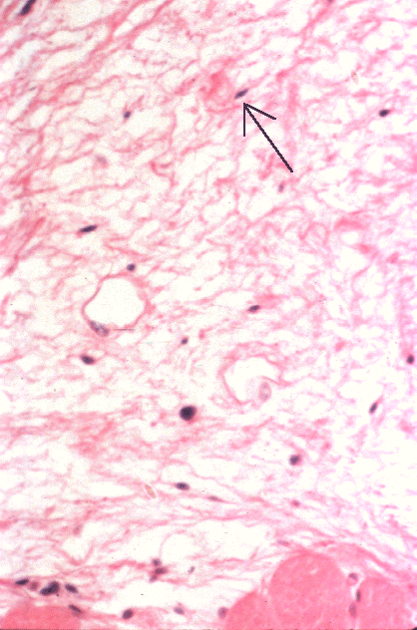
4. Connective tissue – connects all parts of the body and provides support (for example tendons, ligaments, cartilage).

Slide 12
Connective Tissue
The main types are:
  Loose connectives tissue
  Fibrous connective tissue
  Adipose tissue
  Cartilage
  Bone and blood
Differences in structure of each of these types of connective tissue are related to their functions.

Slide 13
Organs
A group of two or more different types of tissue that work together to perform a specific function.
For example, the heart is made of muscle and connective tissues which functions to pump blood throughout the body.

Slide 14
List all the main systems of the body and the main organs they contain.

Slide 15
There are four main types of plant tissue.
  1. Meristematic Tissue:
  Involved in plant growth.
  Found in tips of roots and shoots, in a ring inside stems and branches
  The only place in a plant where cells divide
  2. Dermal Tissue:
  composed of the outer most cell layer of a plant.
  Usually produce a waxy cuticle.
  Protects plants from cuts, micro organisms and water loss

Slide 16
  3. Ground Tissue:
  composed of all internal cells of a plant.
  Different cell types are specialised for specific functions.
  Such as storage, support and photosynthesis
  4. Vascular Tissue:
  Used in the transport of substances.

